Slide 1
Account Types in the Microsoft Identity Platform

Slide 2

Overview
Single organization
Multiple organization
Microsoft account
Applications & service principals

Slide 3
Let’s start with an app
Decisions:
Trust Microsoft identity platform
How will customers get the app
Work for the user or as the app itself
What resources are required and when
When to ask for permission to a resource
Notes:
Developers that leverage the Microsoft identity platform within custom apps begin with registering an application in Azure AD. It doesn’t matter if the app runs on a mobile device or in the cloud. If the runs in the cloud, it doesn't matter which cloud provider hosts it. The app can even be a PowerShell script. The Azure AD application is the control point for how you access the identity and the information it protects.
You as the developer have a number of choices to make and the choices you make are driven by the requirements for your application. Developers have to decide:
- how will customers get the app
- should the app do work on behalf of a user, or as the app itself
- what resources are required by the app, and when are they needed
- when should the app ask the user for permissions to a resource

Slide 4
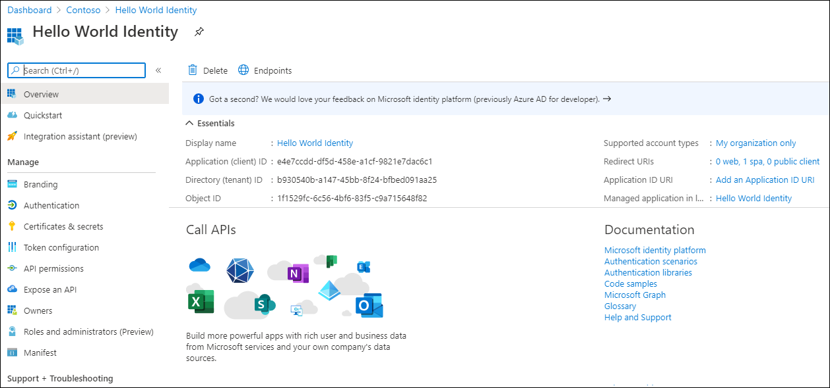
App Registration – App Trusts Microsoft identity platform
What Azure AD considers “the app”
Information about the app:
Name, logo, and publisher
Reply URLs, Secrets, …
One App Registration per App
“Application Object”
Notes:
The first decision is: are you going to trust the Microsoft identity platform? Once you have made the decision to trust the Microsoft identity platform, the next step is to register an application with Azure AD. A key part of creating an Azure AD application is what are the permissions the app requires.
Another key decision you will make when registering the app is what type of accounts will it support? The Microsoft identity platform supports the following types of accounts:
- single organization
- multiple organization
- personal Microsoft accounts

Slide 5

Single Organization App – Users come from only one organization
App registered for a specific Azure AD directory
Single-tenant
Registered with Azure Portal, script, automation provided by developer
Admins decide who can register apps in their tenant
App
Service Principal
Notes:
If you're writing a Line of Business (LOB) application, you can sign in users in your own organization. Applications that sign in users only from the app’s home tenant are called single tenant applications.​
​
Administrators decide who can register applications in the tenant. These could be every user, only administrators, or users with the Application administrator, Cloud application administrator, or Application developer Azure AD administrative roles. Only users within your organization can sign in and use the application; no one outside the organization can use this application.​
​

Slide 6
Multi-Organization App - Making getting your app easier
App registered for use in any Azure Directory or any Azure AD and personal Microsoft accounts (e.g. Skype, Xbox, Outlook.com)
Multi-tenant
Registered in its “Home” directory (same process as single-tenant)
Admins decide who can consent to apps in their tenant
Service Principal
App
Service Principal
Notes:
The other type of application is one that allows users from more than just your organization to sign in and use the application. For example, if you're an independent software vendor (ISV), you can write an application which signs-in users from any organization.
These applications can also allow users to sign in using their personal Microsoft account. Maybe you want to give users the choice of signing into the application using either their work or school account or their personal Microsoft account.

Slide 7
Guidelines for building multi-tenant apps
Multi-tenant apps present challenges with administrators setting different policies in different tenants
Test your app in a tenant configured with Conditional Access policies
Request only the least privileges required for the app to run
Avoid requesting privileges requiring admin consent
Provide names & descriptions for permissions exposed by the app
Notes:
Building great multi-tenant apps can be challenging because of the number of different policies that IT administrators can set in their tenants. When building multi-tenant apps, you should keep a few guidelines in mind.​
Test your app in a tenant that has configured Conditional Access policies. The Conditional Access feature in Azure AD offers one of several ways that IT Pros can use to secure your app and protect a service. Conditional Access enables enterprise customers to protect services in a multitude of ways including multi-factor authentication, allowing only Intune-enrolled devices to access specific services, and restricting user locations and IP ranges. Your application may, or may not, acquire access tokens due to various Conditional Access Polices. Your app must gracefully handle not obtaining an access token.​
Your apps should also follow the principle of least user access to ensure that your app only requests permissions it actually needs. Avoid requesting permissions that require admin consent as this may prevent users from acquiring your app at all in some organizations.​
Finally, provide appropriate names and descriptions for any permissions you expose as part of your app. This helps users and admins know what they are agreeing to when they attempt to use your app's APIs.​

Slide 8
Applications and service principals
Notes:
An application that has been integrated with Azure AD has implications that go beyond the software aspect. "Application" is frequently used as a conceptual term, referring to not only the application software, but also its Azure AD registration and role in authentication/authorization "conversations" at runtime.
When you register an Azure AD application in the Azure portal, two objects are created in your Azure AD tenant:
- application object
- service principal

Slide 9
Application and service principal objects
Application object
What the developer knows about the application​
Authentication parameters​
Secrets or certificates​
Permissions the app will use​
APIs the app exposes​
Define app roles​
​
Azure AD applications are defined by exactly ​ one application object​
​
Resides within the Azure AD tenant where the app was registered​
Service principal object
How the IT Pro determines how the application operates within their tenant​
​
Can limit the application to specific users and groups​
​
Used to review app permissions and grant admin consent​
​
Assign users and/or groups to roles​
​
Configure the app for automatic provisioning​
​ Created when an application is granted permission to a resource ​ in a tenant​
Notes:
Application object​:
The Application object is where developers specify how the app works. This includes parameters for authentication, secrets, or certificates, what permissions the app will use, any APIs the app exposes. ​
Azure AD applications are defined by exactly one application object. The application object resides in the Azure AD tenant where it was registered.​
Service principal object​:
IT Pros use the Service Principal to determine how the application operates within their tenant. The IT PRO can limit the app to specific users and/or groups, review permissions and grant consent, assign users and/or groups to roles, or configure app provisioning.​
For a multi-tenant application, when an application is given permission to access resources in a tenant, a service principal object is created in that tenant​

Slide 10
Application and service principal objects
Application object
Global representation of the application across all tenants
1:1 relationship with the software application
1:many relationship with corresponding service principal objects
Service principal object
Local representation of the application in a specific tenant
Single tenant apps: 1 service principal created & consented during app registration
Multi-tenant apps: 1 service principal in each tenant that has consented to the application’s use
Notes:
Consider the application object as the *global* representation of your application for use across all tenants, and the service principal as the *local* representation for use in a specific tenant.​
Application objects have a 1:1 relationship with the software application, and a 1:many relationship with its corresponding service principal object(s).​
Service principals must be created in each tenant where the application is used, enabling it to establish an identity for sign-in and/or access to resources being secured by the tenant.​
A Single-tenant application has only one service principal (in its home tenant), created and consented for use during application registration.​
Multi-tenant web applications or APIs also have a service principal created in each tenant where a user from that tenant has consented to its use.​

Slide 11
Demo

Slide 12
Thank you.

